Slide 1
Applied Data Science capstone
Huseyin C
December 8, 2023

Slide 2

OUTLINE
Executive Summary
Introduction
Methodology
Results
Discussion
Conclusion

Slide 3
Outline
In this capstone project, our objective is to anticipate the outcome of the SpaceX Falcon 9 first stage landing, utilizing a range of machine learning classification techniques. The primary stages of this endeavor encompass:
Gathering, refining, and organizing the data.
Conducting an exploratory analysis of the data.
Creating interactive data visualizations.
Employing machine learning for predictive purposes.
Our visual representations reveal that certain aspects of the rocket launches exhibit a connection with the outcome, specifically, whether it was a success or failure. Additionally, our analysis suggests that the decision tree algorithm may offer the most promising results in forecasting the successful landing of the Falcon 9 first stage.
EXECUTIVE SUMMARY

Slide 4
Outline
In this capstone project, our primary goal is to predict the successful landing of the Falcon 9 first stage. It's noteworthy that SpaceX promotes Falcon 9 rocket launches on their website at a cost of 62 million dollars, a significantly more budget-friendly option compared to other providers whose charges can soar as high as 165 million dollars per launch. This cost disparity primarily arises from SpaceX's innovative practice of reusing the first stage of the rocket. Consequently, by determining the likelihood of a successful first stage landing, we can ascertain the overall cost of a launch. This valuable information can be instrumental if another company wishes to compete with SpaceX in bidding for a rocket launch contract.
It's important to note that many instances of unsuccessful landings are actually planned occurrences. SpaceX occasionally conducts controlled landings in the ocean for specific purposes.
The central question we aim to address revolves around the following: Given a set of features related to a Falcon 9 rocket launch, encompassing factors such as payload mass, orbit type, launch site, and more, can we reliably predict whether the first stage of the rocket will achieve a successful landing?
INTRODUCTION

Slide 5
Outline
METHODOLOGY
The comprehensive approach encompasses:
Data acquisition, preparation, and structuring, utilizing:
SpaceX API
Web scraping
Exploratory data analysis (EDA), incorporating:
Pandas and NumPy
SQL
Data representation through visualization, employing:
Matplotlib and Seaborn
Folium
Dash
Machine learning forecasting, utilizing:
Logistic regression
Support vector machine (SVM)
Decision tree
K-nearest neighbors (KNN)

Slide 6
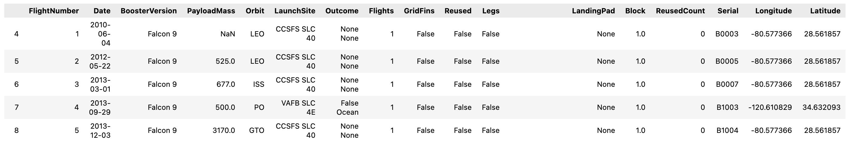
Outline
METHODOLOGY
Data collection, wrangling, and formatting
1
SpaceX API: For our data source, we rely on the SpaceX API, accessible via the URL https://api.spacexdata.com/v4/rockets/. This API furnishes a wealth of information regarding various rocket launches conducted by SpaceX. To streamline our analysis, we narrow our focus exclusively to Falcon 9 launches.
Data Handling: To address missing data points within the dataset, we employ a strategy of imputation. Specifically, any missing values are replaced with the mean value of the respective column to ensure completeness and accuracy.
Data Dimensions: After this data wrangling process, our dataset comprises a total of 90 rows, each representing individual instances, and 17 columns, which correspond to different features. Below, you can find a snapshot illustrating the initial rows of this dataset:

Slide 7

Outline
METHODOLOGY
Data collection, wrangling, and formatting
1
Web Scraping:
To gather additional data for our analysis, we perform web scraping from the webpage located at https://en.wikipedia.org/w/index.php?title=List_of_Falcon_9_and_Falcon_Heavy_launches&oldid=1027686922. It's important to note that this website exclusively contains information pertaining to Falcon 9 launches.
Data Scope: Following the web scraping process, our dataset expands to encompass 121 rows, signifying distinct instances, and includes 11 columns that represent various features. Please refer to the image below for an initial glimpse of the data's initial rows:

Slide 8
Outline
METHODOLOGY
Data collection, wrangling, and formatting
1
Data Processing and Transformation: Subsequent to data collection, we engage in comprehensive data preprocessing. Our approach includes eliminating any missing entries to ensure data completeness. Additionally, categorical features are encoded using one-hot encoding, a technique that converts them into numerical values for analysis.
Introduction of 'Class' Column: A pivotal step in our data transformation involves the introduction of an additional column termed 'Class.' Within this column, a value of 0 is assigned to launches classified as failures, while successful launches are denoted with a value of 1. This binary classification serves as a fundamental element of our analysis.
Final Data Dimensions: Upon completing these data processing steps, our dataset is streamlined to consist of 90 rows, each representing unique instances, and a total of 83 columns, encompassing various features for analysis and prediction.

Slide 9



Outline
METHODOLOGY
Exploratory Data Analysis (EDA)
2
Pandas and NumPy: We harness the capabilities of the Pandas and NumPy libraries to perform fundamental data analysis tasks. This includes computing essential statistics and insights such as:
Determining the count of launches conducted at each individual launch site.
Tabulating the frequency of each specific orbit in our dataset.
Establishing the count and prevalence of different mission outcomes.
SQL Queries: Furthermore, we employ SQL queries to extract valuable information from our dataset, addressing pertinent questions such as:
Identifying the distinct names of launch sites participating in space missions.
Calculating the total payload mass transported by boosters launched under NASA's CRS (Commercial Resupply Services) program.
Evaluating the average payload mass carried by booster version F9 v1.1.
These analytical approaches, encompassing both Pandas/NumPy and SQL, are pivotal in gaining deeper insights into our data.

Slide 10



Outline
METHODOLOGY
Data Visualization
3
Matplotlib and Seaborn:
Incorporating functions from the Matplotlib and Seaborn libraries, we employ various visualization techniques, including scatterplots, bar charts, and line charts. These visual representations enable us to explore and comprehend relationships among different features in our dataset, notably:
1. Examining the correlation between flight number and launch site.
2. Analyzing how payload mass relates to the launch site.
3. Investigating the success rate in relation to the type of orbit.
Folium:
To enhance our data visualization capabilities, we leverage the Folium library to create interactive maps. This facilitates the following visualizations:
1. Pinpointing all launch sites on a map for geographical context.
2. Distinguishing between successful and failed launches for each site, offering insights into performance.
3. Mapping the distances between launch sites and key proximities such as the nearest city, railway, or highway, aiding in spatial analysis.
These visualization tools, including Matplotlib, Seaborn, and Folium, play a crucial role in our data exploration and presentation.

Slide 11

Outline
METHODOLOGY
Data Visualization
3
Dash Integration:
We integrate the capabilities of the Dash library to create an interactive web-based platform. This platform features user-friendly elements such as a dropdown menu and a range slider, which allow users to toggle inputs and customize their data exploration experience.
Interactive Site Content:
Within this interactive site, we present information through a pie chart and a scatterplot, offering valuable insights into our dataset, including:
1. Total successful launches originating from each launch site, providing a comprehensive overview of success rates across different locations.
2. The correlation between payload mass and mission outcomes (success or failure) for each launch site, using a scatterplot. This allows for a nuanced examination of how payload mass influences mission success at specific launch sites.
Dash empowers users to interact with and explore the data interactively, fostering a deeper understanding of the relationships and trends within our dataset.

Slide 12

Outline
METHODOLOGY
Machine Learning Prediction
4
Scikit-Learn for Machine Learning:
To develop our machine learning models, we leverage functions and tools from the Scikit-Learn library, a robust resource for machine learning tasks. Our machine learning prediction phase encompasses several essential steps:
1. Data Standardization:
- Ensuring that our data is standardized, which often involves scaling numerical features to have a consistent range.
2. Data Splitting:
- Segregating the dataset into distinct training and test sets. This division is crucial for training and validating the models.
3. Machine Learning Model Creation:
- Developing various machine learning models to facilitate predictions. These models encompass:
- Logistic regression
- Support vector machine (SVM)
- Decision tree
- K nearest neighbors (KNN)
4. Model Training:
- Fitting these machine learning models on the training set to enable them to learn from the data.
5. Hyperparameter Tuning:
- Identifying the optimal combination of hyperparameters for each model. This process enhances model performance.
6. Model Evaluation:
- Assessing the models based on their accuracy scores, which indicate their predictive capability, and utilizing confusion matrices to gain insights into their classification performance.
These machine learning steps using Scikit-Learn allow us to make informed predictions and draw meaningful conclusions from our data.

Slide 13
Outline
RESULTS
1. SQL (EDA with SQL):
- Exploratory Data Analysis conducted using SQL, likely involving data queries and insights extracted from your dataset.
2. Matplotlib and Seaborn (EDA with Visualization):
- Exploratory Data Analysis facilitated through data visualization techniques using Matplotlib and Seaborn, with a particular focus on the relationships and patterns within the data.
3. Folium:
- Visualizations and spatial analysis carried out using the Folium library, which likely includes interactive maps and geographical insights.
4. Dash:
- An interactive web-based platform created with Dash, showcasing insights from your data through pie charts and scatterplots.
5. Predictive Analysis:
- The phase where machine learning models, including logistic regression, support vector machine, decision tree, and K-nearest neighbors, are employed for predictive analysis, with a specific focus on classifying launches as either successful (class 1) or failed (class 0).
In all of these sections, the distinction between class 0 (failed launch outcome) and class 1 (successful launch outcome) is maintained, allowing for a clear interpretation of the results. If you have any specific questions or if there's a particular section you'd like to discuss further, please let me know.

Slide 14
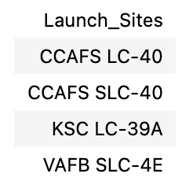
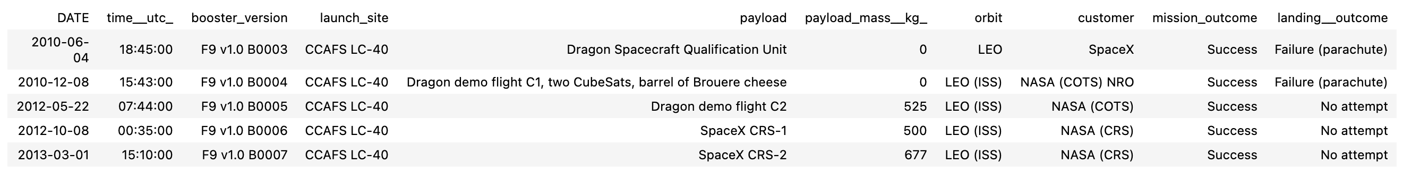
Outline
RESULTS
SQL (EDA with SQL)
1
The names of the unique launch sites in the space mission
5 records where launch sites begin with ‘CCA’

Slide 15
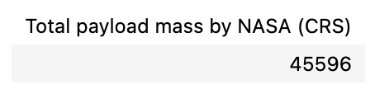
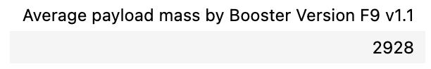
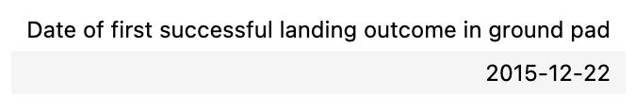
Outline
RESULTS
SQL (EDA with SQL)
1
The total payload mass carried by boosters launched by NASA (CRS)
The average payload mass carried by booster version F9 v1.1
The date when the first successful landing outcome in ground pad was achieved

Slide 16
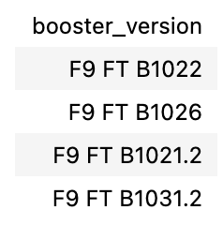
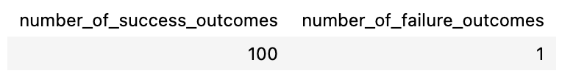
Outline
RESULTS
SQL (EDA with SQL)
1
The names of the boosters which have success in drone ship and have payload mass greater than 4000 but less than 6000
The total number of successful and failure mission outcomes

Slide 17
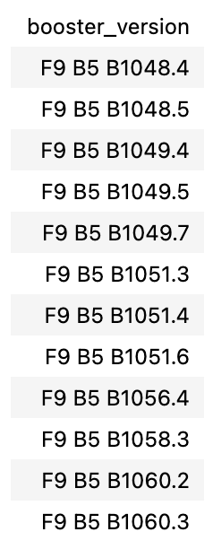
Outline
RESULTS
SQL (EDA with SQL)
1
The names of the booster versions which have carried the maximum payload mass

Slide 18
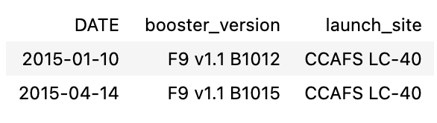
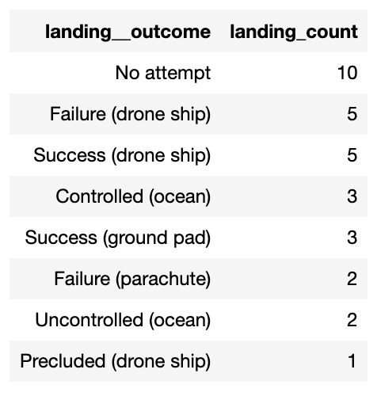
Outline
RESULTS
SQL (EDA with SQL)
1
The failed landing outcomes in drone ship, their booster versions, and launch site names for in year 2015
The count of landing outcomes between the date 2010-06-04 and 2017-03-20, in descending order

Slide 19
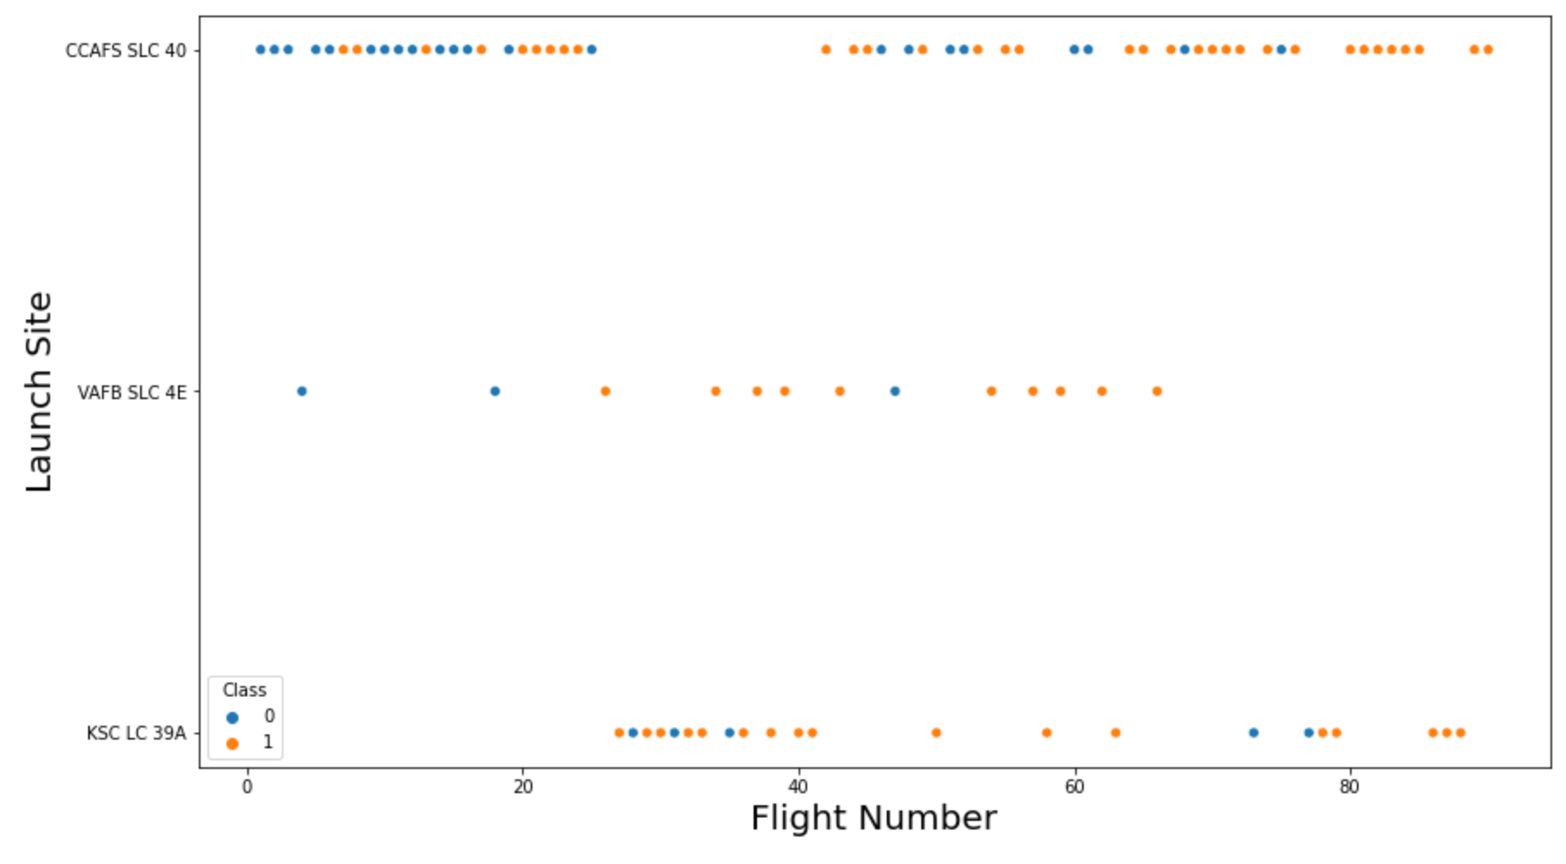
Outline
RESULTS
Matplotlib and Seaborn (EDA with Visualization)
2
The relationship between flight number and launch site

Slide 20
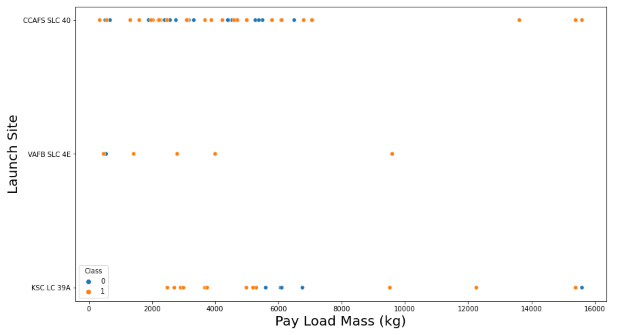
Outline
RESULTS
Matplotlib and Seaborn (EDA with Visualization)
2
The relationship between payload mass and launch site

Slide 21
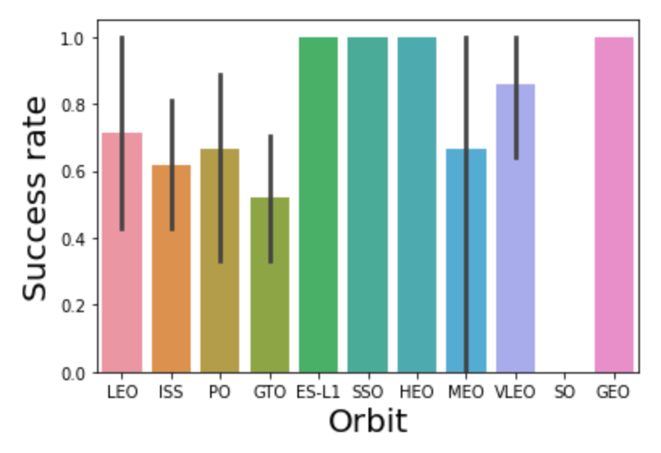
Outline
RESULTS
Matplotlib and Seaborn (EDA with Visualization)
2
The relationship between success rate and orbit type

Slide 22
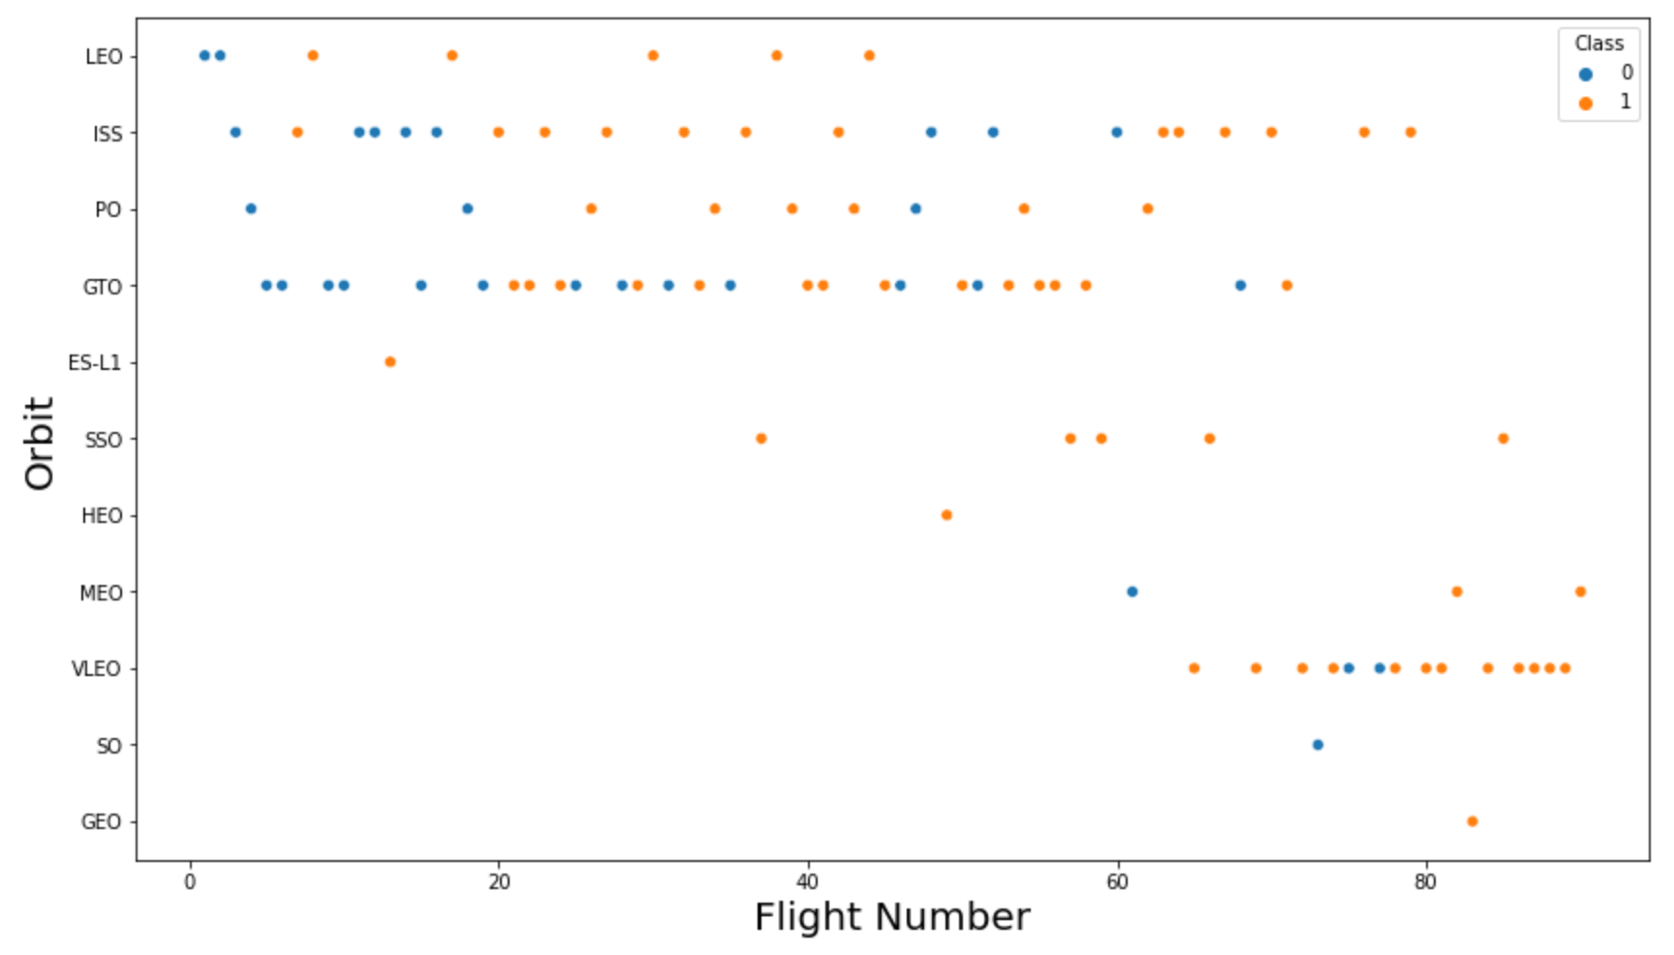
Outline
RESULTS
Matplotlib and Seaborn (EDA with Visualization)
2
The relationship between flight number and orbit type

Slide 23
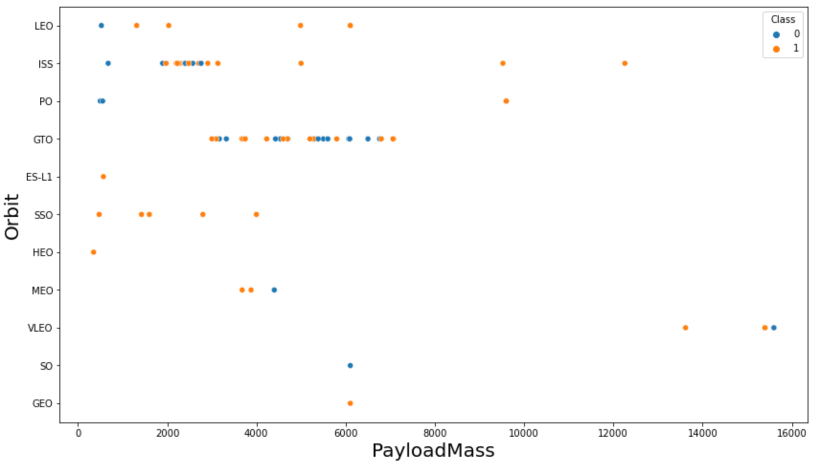
Outline
RESULTS
Matplotlib and Seaborn (EDA with Visualization)
2
The relationship between payload mass and orbit type

Slide 24
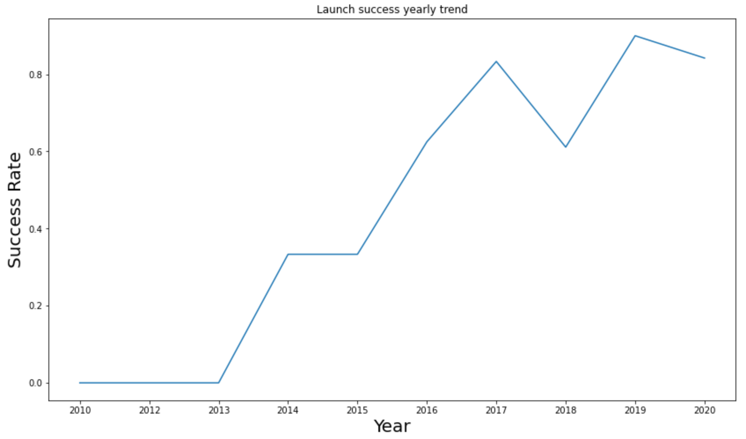
Outline
RESULTS
Matplotlib and Seaborn (EDA with Visualization)
2
The launch success yearly trend

Slide 25

Outline
RESULTS
Folium
3
All launch sites on map

Slide 26
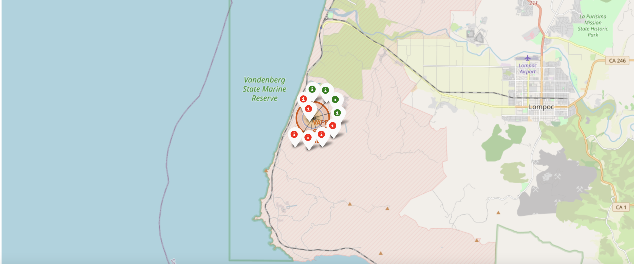
Outline
RESULTS
Folium
3
The succeeded launches and failed launches for each site on map
If we zoom in on one of the launch site, we can see green and red tags. Each green tag represents a successful launch while each red tag represents a failed launch

Slide 27
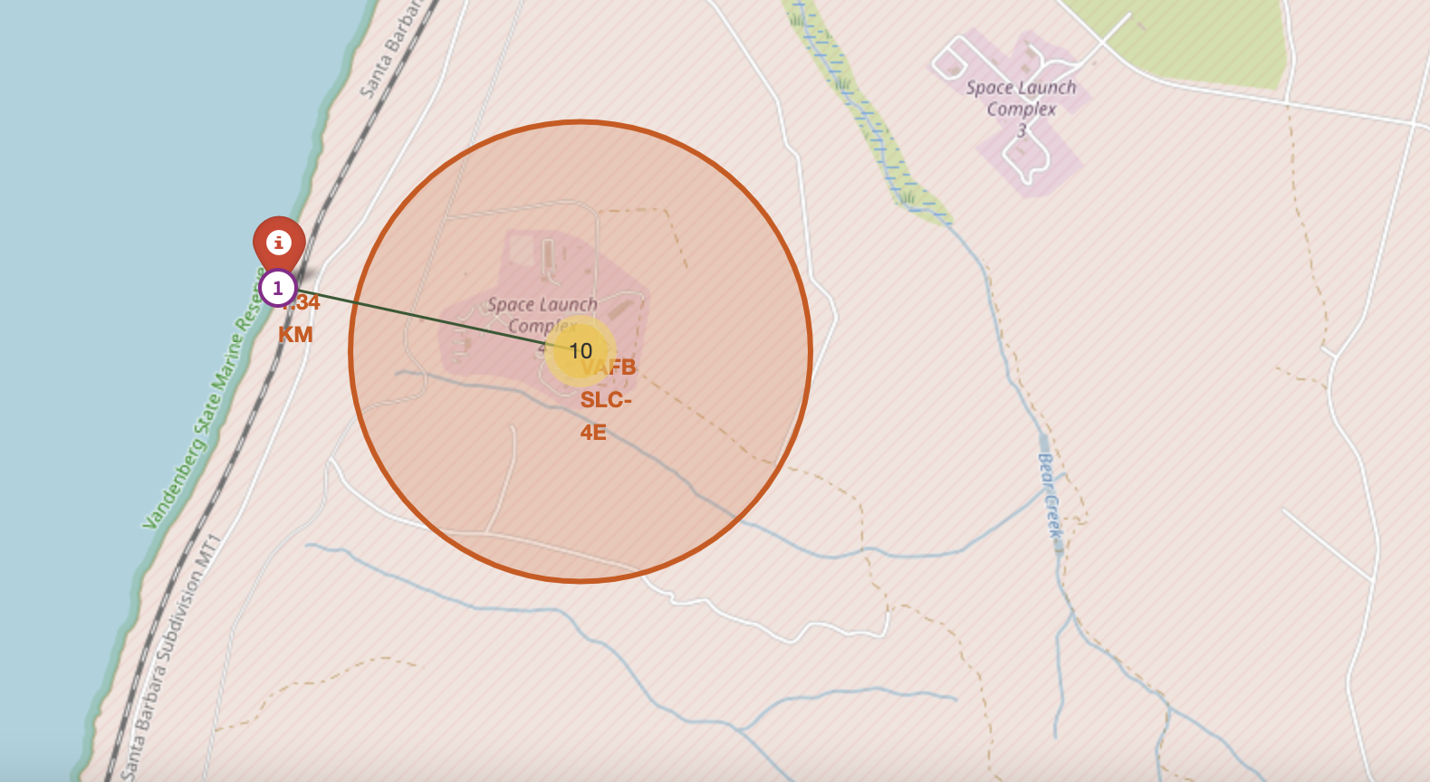
Outline
RESULTS
Folium
3
The distances between a launch site to its proximities such as the nearest city, railway, or highway
The picture below shows the distance between the VAFB SLC-4E launch site and the nearest coastline

Slide 28

Outline
RESULTS
Dash
4
The picture below shows a pie chart when launch site CCAFS LC-40 is chosen.
0 represents failed launches while 1 represents successful launches. We can see that 73.1% of launches done at CCAFS LC-40 are failed launches.

Slide 29
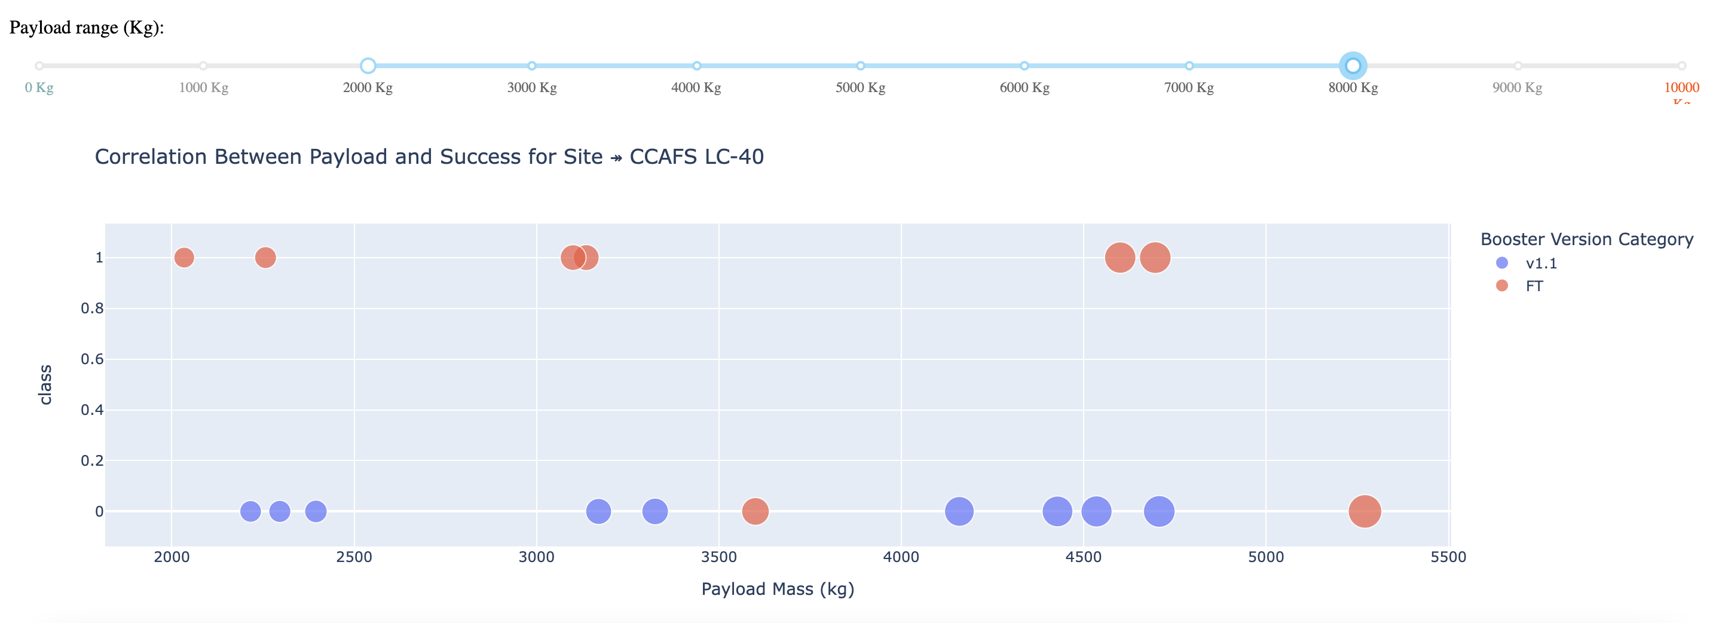
Outline
RESULTS
Dash
4
The picture below shows a scatterplot when the payload mass range is set to be from 2000kg to 8000kg.
Class 0 represents failed launches while class 1 represents successful launches.

Slide 30

Outline
RESULTS
Predictive Analysis
5
Logistic regression
GridSearchCV best score: 0.8464285714285713
Accuracy score on test set: 0.8333333333333334
Confusion matrix:

Slide 31
Outline
RESULTS
Predictive Analysis
5
Support vector machine (SVM)
GridSearchCV best score: 0.8482142857142856
Accuracy score on test set: 0.8333333333333334
Confusion matrix:

Slide 32
Outline
RESULTS
Predictive Analysis
5
Decision tree
GridSearchCV best score: 0.8892857142857142
Accuracy score on test set: 0.8333333333333334
Confusion matrix:

Slide 33
Outline
RESULTS
Predictive Analysis
5
K nearest neighbors (KNN)
GridSearchCV best score: 0.8482142857142858
Accuracy score on test set: 0.8333333333333334
Confusion matrix:

Slide 34
Outline
RESULTS
Predictive Analysis
5
When we juxtapose the outcomes of all four models, it becomes evident that they exhibit identical accuracy scores and confusion matrices during their evaluation on the test dataset. Consequently, we resort to their GridSearchCV best scores as the determining factor for ranking these models. In accordance with the GridSearchCV best scores, the models are arranged in the following order, with the top performer listed first and the least performer listed last:
Decision tree (GridSearchCV best score: 0.8892857142857142)
K nearest neighbors, KNN (GridSearchCV best score: 0.8482142857142858)
Support vector machine, SVM (GridSearchCV best score: 0.8482142857142856)
Logistic regression (GridSearchCV best score: 0.8464285714285713)

Slide 35
Outline
DISCUSSION
In the data visualization segment, it becomes evident that certain features exhibit correlations with the mission outcome, manifesting in various patterns. For instance, when dealing with heavy payloads, we observe a higher likelihood of successful landings or positive mission outcomes for specific orbit types, namely Polar, LEO, and ISS. However, when it comes to GTO, distinguishing between these outcomes is more challenging, as both positive landing rates and negative outcomes (unsuccessful missions) coexist.
As a result, each feature within the dataset appears to exert a distinct influence on the ultimate mission outcome. While deciphering the precise mechanisms by which these features impact mission success can be intricate, we can leverage machine learning algorithms to analyze historical data patterns. By doing so, we can predict whether a mission will achieve success or not based on the provided features.

Slide 36
Outline
CONCLUSION
This project's primary objective is to forecast whether the first stage of a Falcon 9 launch will achieve a successful landing, enabling us to ascertain the cost associated with the launch. Each feature associated with a Falcon 9 launch, be it payload mass or orbit type, is believed to exert a distinct influence on the mission's outcome.
To achieve this, we deploy a variety of machine learning algorithms to discern patterns within historical Falcon 9 launch data. These algorithms generate predictive models capable of anticipating the outcome of future Falcon 9 launches.
Among the four machine learning algorithms utilized, the decision tree algorithm emerged as the top performer, yielding the most accurate predictive model.

